Slide 1
Biometric Recognition Labs

Slide 2

Teacher
Kevin Hernández Díaz
Email: Kevin.Hernandez-diaz@hh.se
Office: F509

Slide 3
Labs Exercises & Evaluation
Matlab software:
Signal Processing Toolbox
Image Processing Toolbox
Image Acquisition Toolbox
5 labs divided in 6 sessions:
1st Matlab and Signals
2nd & 3rd Hand Geometry – report
4th Linear Filtering
5th Fingerprint Recognition – report
Reports will be submitted through Blackboard. In groups of 2-3 students max. Groups for this will be created like the lab groups

Slide 4
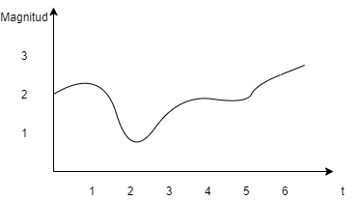
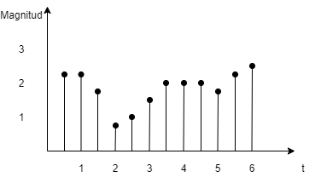
Lab 1: Matlab and Signals
Signals in one dimensions:
Continuous signals
Defined at every value of t
Infinite values
Discrete signals
Finite number of values for the magnitude
Finite number of values in t
Capable of being treated in digital devices!

Slide 5
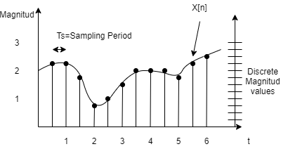
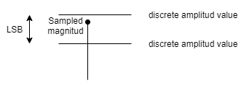
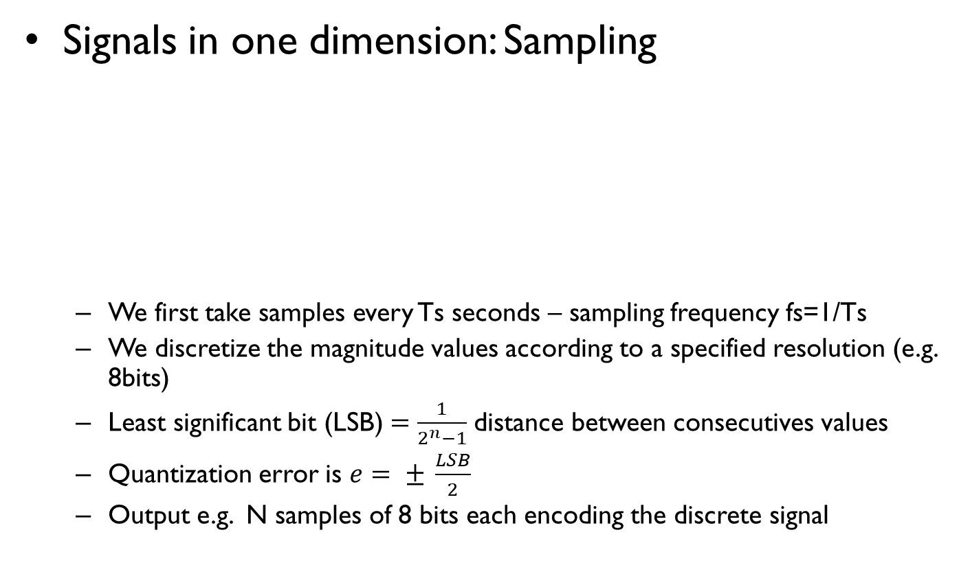
Lab 1: Matlab and Signals
Signals in one dimension: Sampling
We first take samples every Ts seconds – sampling frequency fs=1/Ts
We discretize the magnitude values according to a specified resolution (e.g. 8bits)
Least significant bit (LSB) $=\frac{1}{2^{n}−1}$distance between consecutives values
Quantization error is $e= ± \frac{LSB}{2}$
Output e.g. N samples of 8 bits each encoding the discrete signal

Slide 6
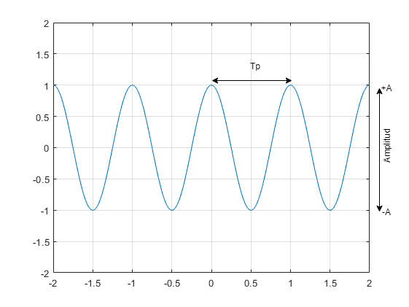

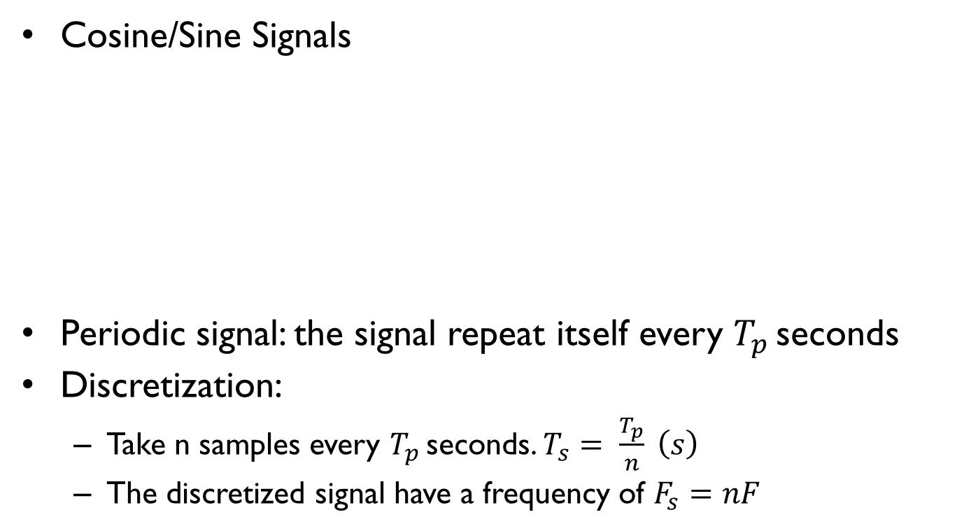
Lab 1 Matlab and Signals
Cosine/Sine Signals
Periodic signal: the signal repeat itself every $T_{p }$seconds
Discretization:
Take n samples every $T_{p }$seconds. $T_{s}= \frac{T_{p}}{n} \left(s\right)$
The discretized signal have a frequency of $F_{s}=nF$
$$x\left(t\right)=A ∗\cos\left(πt+ φ\right)$$
$ω=2∗π∗F=\frac{2π}{T_{p}}$ (rad/s)
$F=\frac{1}{T_{p}}$ (Hz)
$T_{p} (sec)$

Slide 7
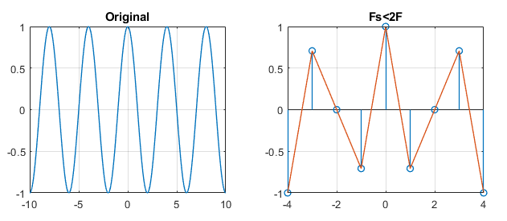
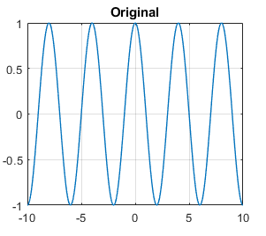
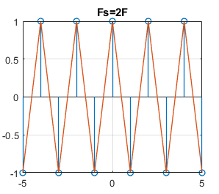
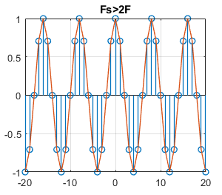

Lab 1 Matlab and Signals
Sampling frequency of cosines
If $F_{s}<2F$:
Loss of information!
If $F_{s}=2F:$
Good enough!
If $F_{s}>2F:$
More information
retained
Fs must be at
least 2 times F!

Slide 8
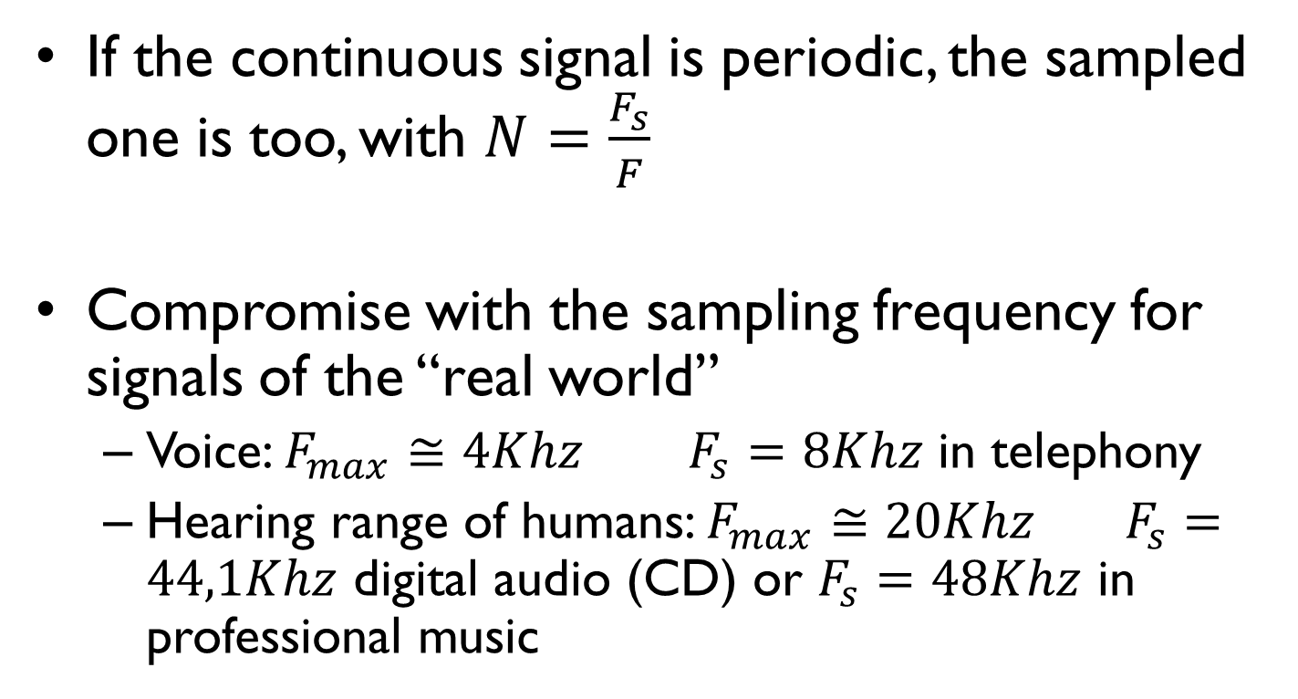
Lab 1 Matlab and Signals
If the continuous signal is periodic, the sampled one is too, with $N=\frac{F_{s}}{F}$
Compromise with the sampling frequency for signals of the “real world”
Voice: $F_{max}≅4Khz$ $F_{s}=8Khz$ in telephony
Hearing range of humans: $F_{max}≅20Khz$ $F_{s}=44,1Khz$ digital audio (CD) or $F_{s}=48Khz$ in professional music

Slide 9
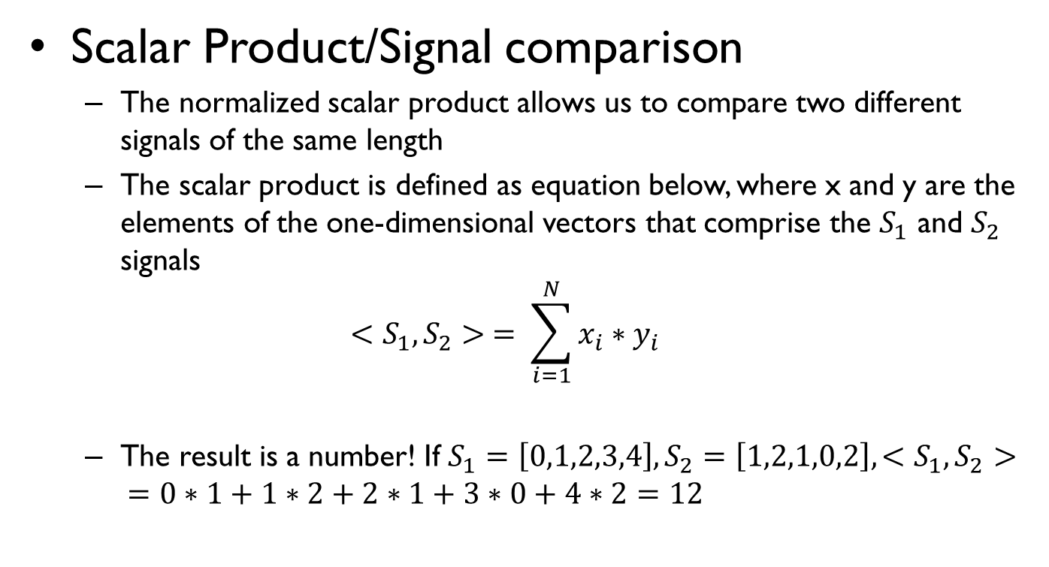
Lab 1 Matlab and Signals
Scalar Product/Signal comparison
The normalized scalar product allows us to compare two different signals of the same length
The scalar product is defined as equation below, where x and y are the elements of the one-dimensional vectors that comprise the $S_{1}$ and $S_{2}$ signals
$$<S_{1},S_{2}> = \sum_{i=1}^{N}{x_{i}∗y_{i}}$$
The result is a number! If $S_{1}=\left[0,1,2,3,4\right], S_{2}=\left[1,2,1,0,2\right],<S_{1},S_{2}> =0∗1+1∗2+2∗1+3∗0+4∗2=12$

Slide 10
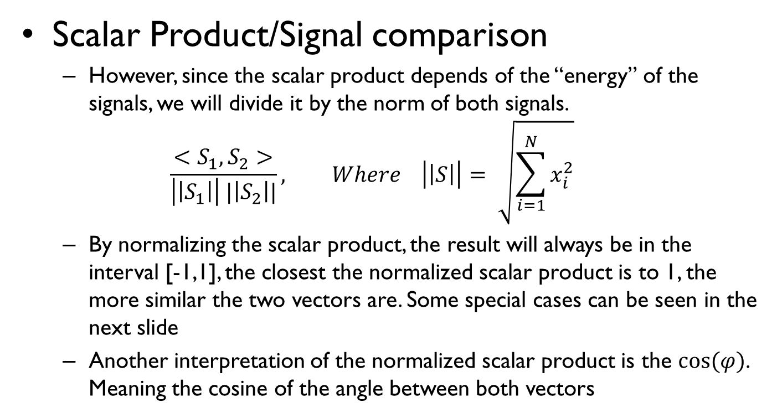
Lab 1 Matlab and Signals
Scalar Product/Signal comparison
However, since the scalar product depends of the “energy” of the signals, we will divide it by the norm of both signals.
$$\frac{<S_{1},S_{2}>}{\left|\left|S_{1}\right|\right| |\left|S_{2}\right||}, Where \left|\left|S\right|\right|= \sqrt{\sum_{i=1}^{N}{x_{i}^{2}}}$$
By normalizing the scalar product, the result will always be in the interval [-1,1], the closest the normalized scalar product is to 1, the more similar the two vectors are. Some special cases can be seen in the next slide
Another interpretation of the normalized scalar product is the $cos⁡(φ)$. Meaning the cosine of the angle between both vectors

Slide 11
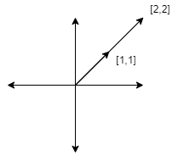
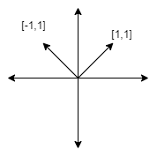
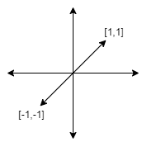
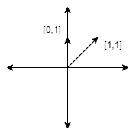
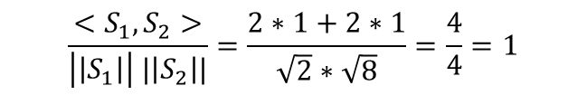
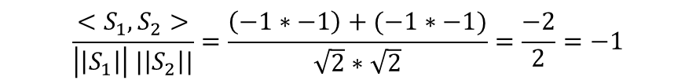
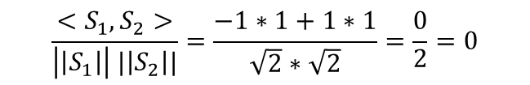
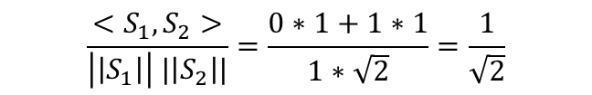
Lab 1 Matlab and Signals
Scalar Product/Signal comparison
$$\frac{<S_{1},S_{2}>}{\left|\left|S_{1}\right|\right| |\left|S_{2}\right||}=\frac{2∗1+2∗1}{\sqrt{2}∗\sqrt{8}}=\frac{4}{4}=1$$
$$\frac{<S_{1},S_{2}>}{\left|\left|S_{1}\right|\right| |\left|S_{2}\right||}=\frac{−1∗1+1∗1}{\sqrt{2}∗\sqrt{2}}=\frac{0}{2}=0$$
$$\frac{<S_{1},S_{2}>}{\left|\left|S_{1}\right|\right| |\left|S_{2}\right||}=\frac{\left(−1∗−1\right)+(−1∗−1)}{\sqrt{2}∗\sqrt{2}}=\frac{−2}{2}=−1$$
$$\frac{<S_{1},S_{2}>}{\left|\left|S_{1}\right|\right| |\left|S_{2}\right||}=\frac{0∗1+1∗1}{1∗\sqrt{2}}=\frac{1}{\sqrt{2}}$$

Slide 12
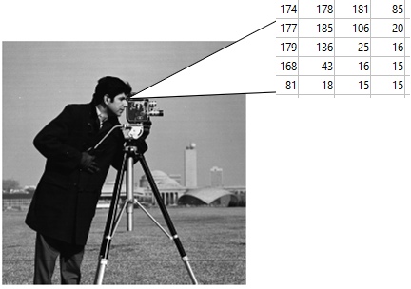
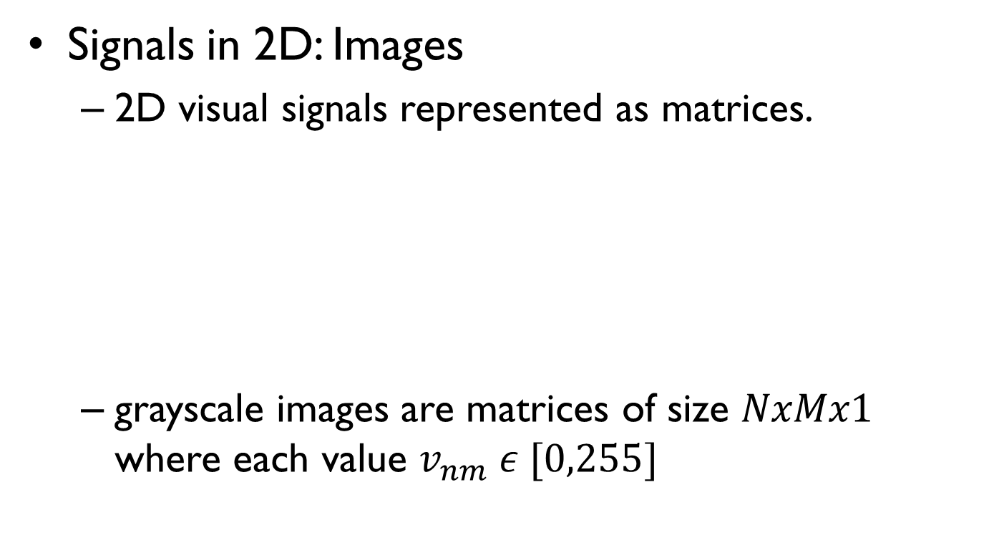
Lab 1 Matlab and Signals
Signals in 2D: Images
2D visual signals represented as matrices.
grayscale images are matrices of size $NxMx1$ where each value $v_{nm} ε [0,255]$

Slide 13
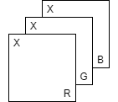
Lab 1 Matlab and Signals
Signals in 2D: Images
Color images consist of 3 2D matrices, where each one represents the brightness of each color in the RGB image
$$pixel X=\left[R,G,B\right] with R,G,B ε [0,255]$$

Slide 14
Lab 1 Matlab and Signals
Images in Matlab:
Matlab treat images as normal matrices, and for so, it index their values in the same way, by rows and columns I(r,c)
We can assign values to those position in the same way. E.g. I(5:6,3:5)=0 changes all pixels in the yellow area to 0
columns
 | 1 | 2 | 3 | 4 | 5 | 6 | 7 | 8
1 | x | x | x | x | x | x | x | x
2 | x
3 | x
4 | x
5 | x |  | x | x | x
6 | x |  | x | x | x
7 | x
8 | x
One pixel (green): I(r,c) e.g. I(1,5)
A row of pixels (blue): I(r,:) e.g. I(3,:)
A column (red): I(:,c) e.g. I(:,7)
An area (yellow): I(r1:r2,c1:c2) e.g. I(5:6,3:5)
row

Slide 15
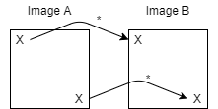
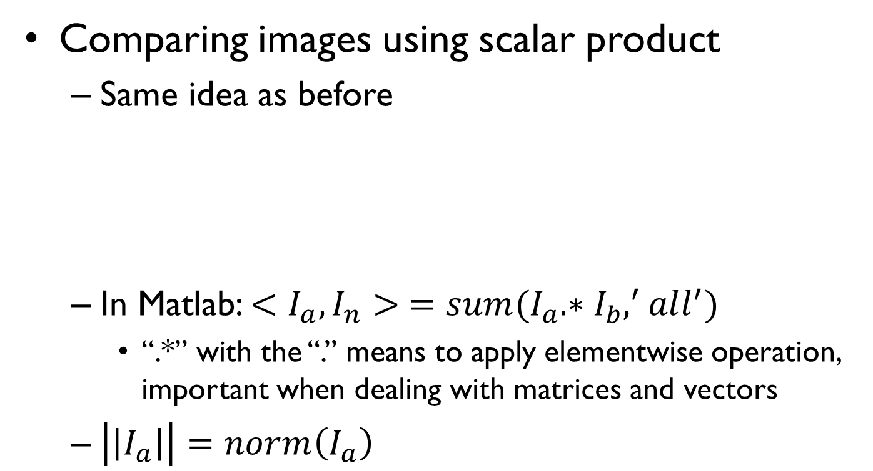
Lab 1 Matlab and Signals
Comparing images using scalar product
Same idea as before
In Matlab: $<I_{a},I_{n}> =sum(I_{a}.∗I_{b},^{′}all^{′})$
“.*” with the “.” means to apply elementwise operation, important when dealing with matrices and vectors
$\left|\left|I_{a}\right|\right|=norm\left(I_{a}\right)$

